Slide 1
IMAGE AND VIDEO STEGANOGRAPHY
DOMAIN : Machine Learning
PROJECT GUIDE : Dr M.Maheswari M.Tech.,Ph .D,
SDG GOAL :8 - DECENT WORK AND ECONOMIC GROWTH
TEAM MEMBERS :
ESAIYARASI V (211420104076)
MONICA K (211420104166)
AKILA LOURDES MF (211420104013)

Slide 2
AGENDA
Abstract
Introduction
Modules Description
Literature survey
System Study
System Architecture
Design Architecture
Existing System
Proposed System
Technological Stack

Slide 3
ABSTRACT
For secure data transmission over internet, it is important to transfer data in high security and high confidentiality, information security is the most important issue of data communication in networks and internet. Either Image or video to secure transferred information from intruders Using RC6 Algorithm, it is important to convert the information into cryptic format the Image and video work on the same process.

Slide 4
INTRODUCTION
Image and video steganography using the RC6 algorithm involves hiding secret information within image or video files. RC6 is a symmetric key block cipher that can encrypt and decrypt data. In this context, it is used to embed secret messages or data into the pixels of an image or frames of a video without altering the perceptual quality of the media. This hidden information can be extracted later using the same key and algorithm, providing a covert communication channel.

Slide 5
MODULES
Video steganography is the art and science of hiding secret data within a video file without altering the perceptual quality of the video. It involves embedding data in a way that is imperceptible to the human eye or ear but can be extracted by authorized parties using a specific technique.
Decoding Algorithm:
User Interface:
MODULES DESCRIPTION Video Processing Module:
Security Module:
Encoding Algorithm:

Slide 6
LITERATURE SURVEY
Title: A Survey Different Video | Author: Ramadhan J. Mstafa; | Year: 2020 | Recent developments in the speed of the Internet and information technology have made the rapid exchange of multimedia information possible.
Title: Video steganography | Author: A.J. Mozo; M.E. Obien; | Year: 2020 | The project aims to describe our research and software implementation in the field of video steganography. Because of security threats today through modern malevolent technology,
Title: A New Video Stegano | Author: J. Mary Jenifer; S. Raja | Year: 2020 | Steganography is the method of hiding the secret message inside the data source. It not only keeps the information as secret but also the existence of the information is kept as secret. .

Slide 7
LITERATURE SURVEY
Title: Video steganography | Author: Yangping Lin; Zhiqiang Ning; | Year: 2022 | In recent years, the steganography scheme based on neural network has made many significant progress on images, but it is still in the exploratory stage in the field of video steganography.
Title: Video steganography | Author: A.J. Mozo; M.E. Obien; | Year: 2020 | The project aims to describe our research and software implementation in the field of video steganography. Because of security threats today through modern malevolent technology,

Slide 8
PROPOSED SYSTEM
The security of data communication and especially images or video frames from images became a significant goal as the network is growing. The security of images from the video is an important research field in different trends like data security, secure data transmission and copyright security. So, Image encryption algorithms and hiding algorithms should be designed to enhance the effectiveness of transmission and keep safety from attacks by the intruders.

Slide 9
TECHNOLOGY STACK
Hardware requirements:
Processor - I5
Speed - 3 GHz
RAM - 8 GB(min)
Hard Disk - 500 GB
Key Board - Standard Windows Keyboard
Mouse - Two or Three Button Mouse
Monitor - LCD

Slide 10
TECHNOLOGY STACK
SOFTWARE CONFIGURATION
Operating System - Linux, Windows/7/10
Server - Anaconda, Jupyter,pycharm
Front End - tkinter |GUI toolkit
Server side Script - Python , AIML

Slide 11
OBJECTIVE
Cryptography is where security engineering meets mathematics. Cryptography is the art of physical scrambling of information using rearrangement and substitution ciphers which can only be read correctly by targeted person having the key. A video is a moving stream of number of images, so high amount of data can be embedded in it. Its relative complexity also gives an advantage over other types of media such as image and audio in terms of security against intruders.

Slide 12
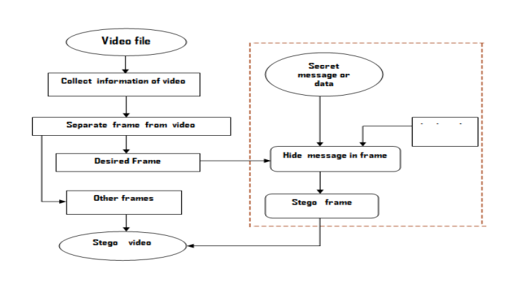
SYSTEM ARCHITECTURE

Slide 13
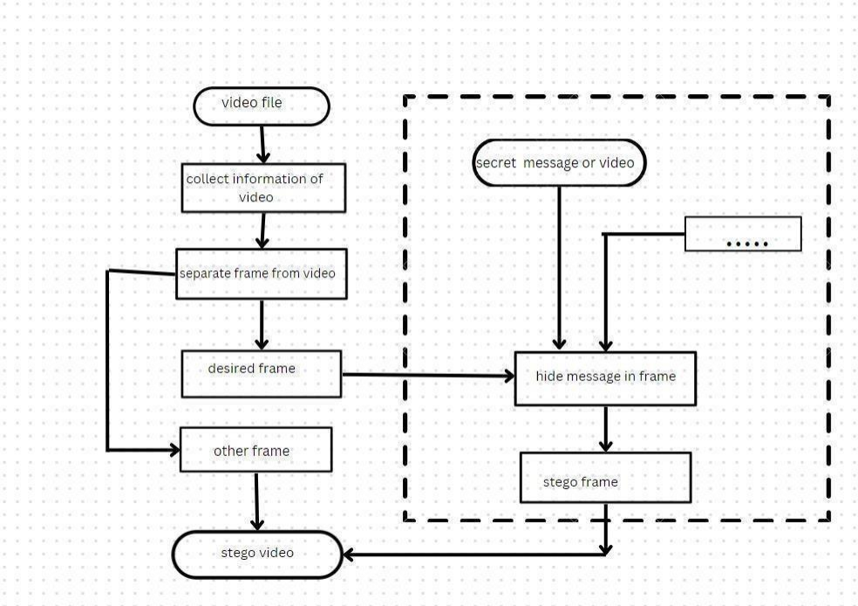
DESIGN ARCHITECTURE

Slide 14
RC6 ALGORITHM
RC6:
RC6 is a derivative of RC5 and is a block cipher designed for RSA Security. RC6 uses four working block size registers in its algorithmic computations, whereas RC5 uses only two.
Thus, RC6 is faster. RC6 was designed as part of the Advanced Encryption Standard (AES) competition, where it was a finalist.
It is a propriety algorithm patented by RSA Security.
RC6 is a fast block cipher. It was developed based on RC5 and does its job quicker than RC5 due to more registers.
RC6 uses integer multiplication in its algorithmic computation. RC6 is also rotation-dependent on every word bit.

Slide 15
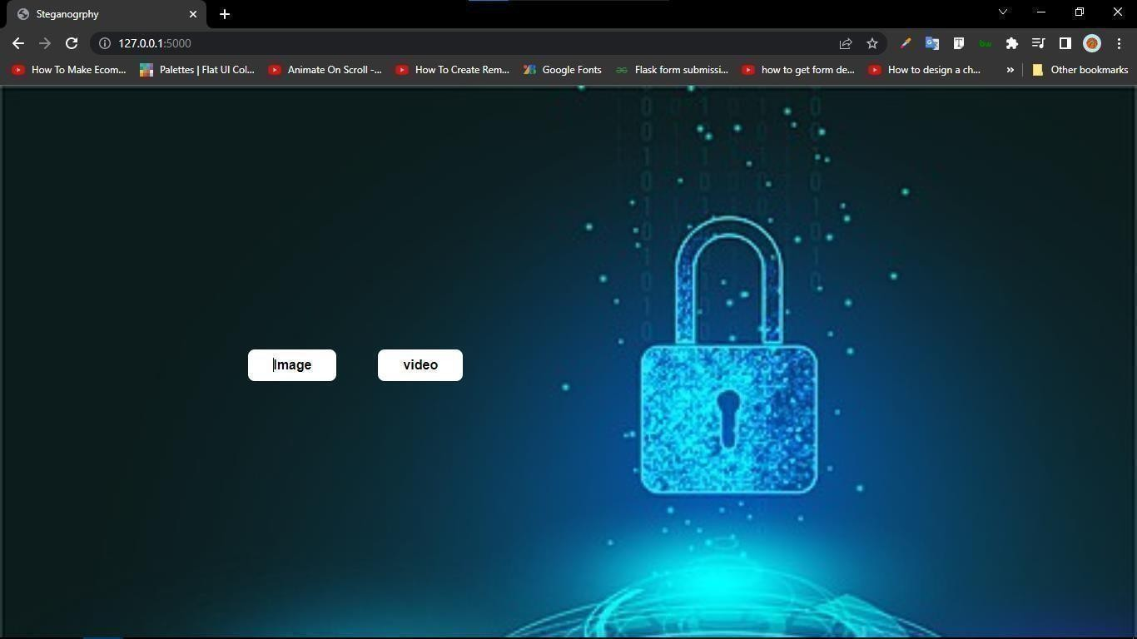
SCREENSHOT
Displays image and video button for steganography

Slide 16
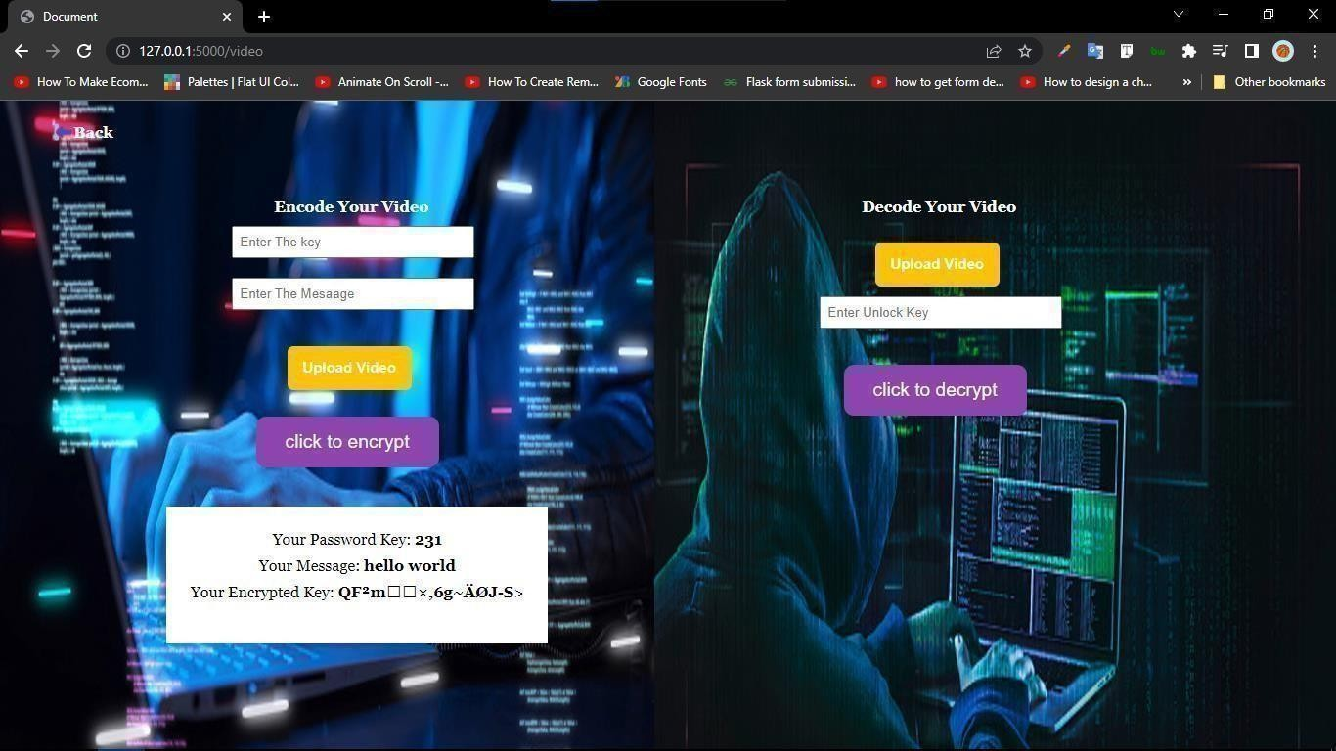
SCREENSHOT
choosing a video for steganography and entering the text which need to be encrypt and also entering the key for encryption.

Slide 17
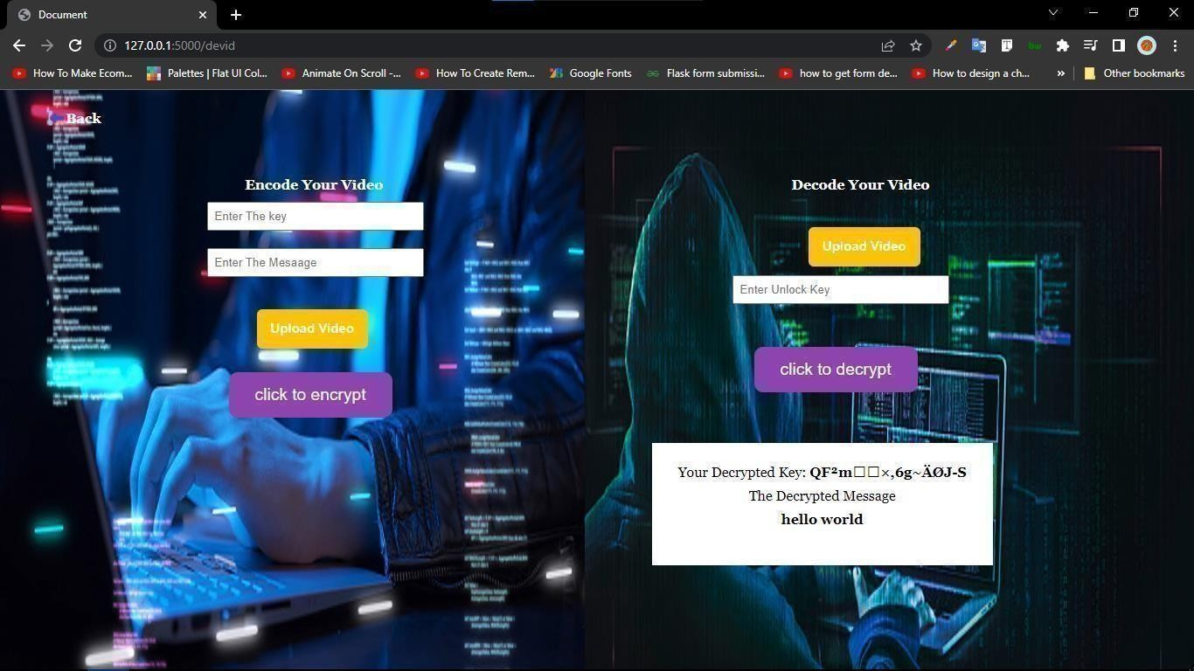
SCREENSHOT
Decrypts the text using the key and decrypting algorithm

Slide 18
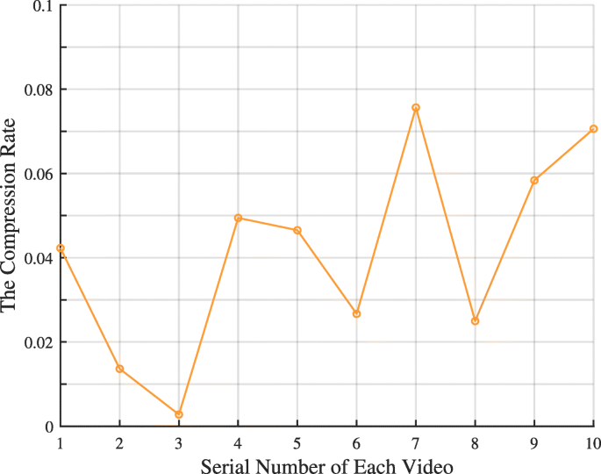
Graph

